Slide 1
Introduction to Continuous Integration

Slide 2
Automating the integration of code changes from multiple contributors into a single software project
From https://www.atlassian.com/continuous-delivery/continuous-integration
Notes:
2

Slide 3
Automatically running a (simple) program after pushing some code changes
Sven's definition
Notes:
3

Slide 4
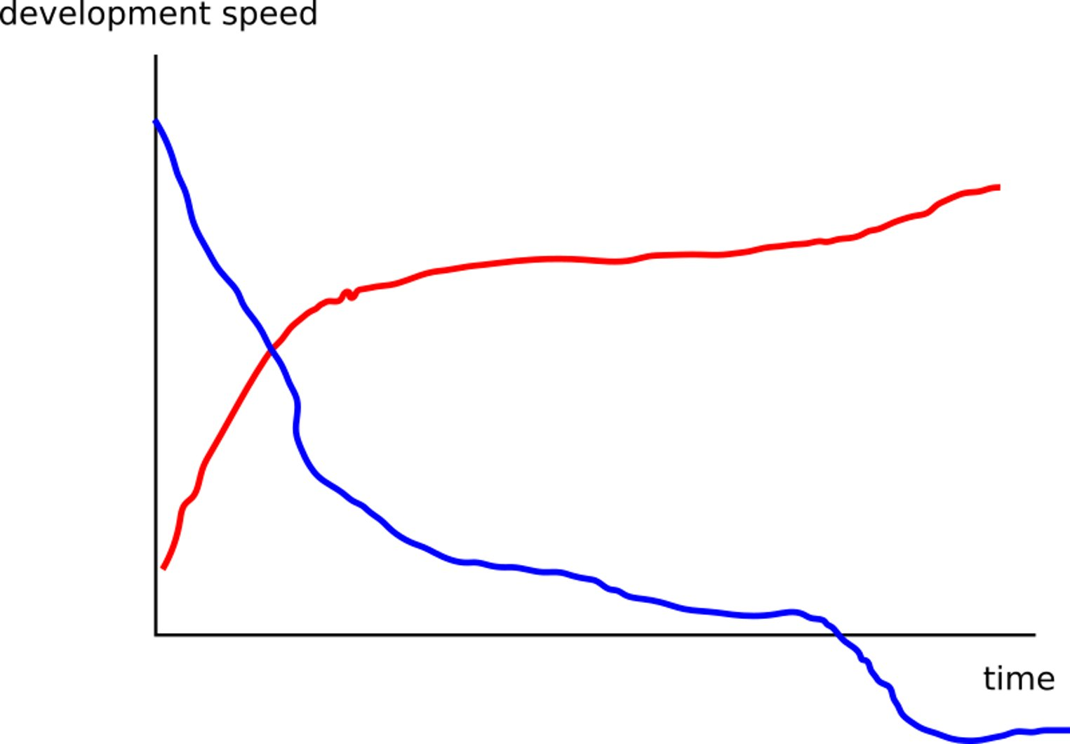
Notes:
4

Slide 5
Continuous integration
How do I setup continuous integration with GitHub?
For what can I use continuous integration?
Notes:
5

Slide 6
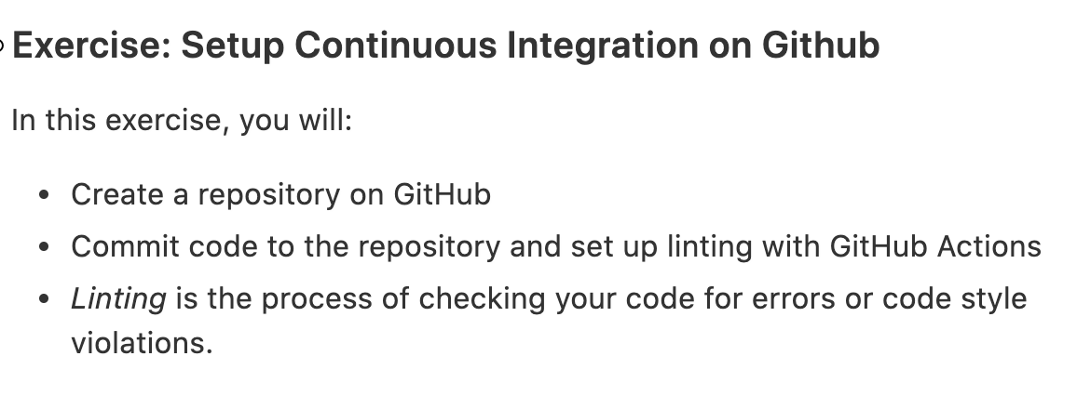
Notes:
6

Slide 7
For what can I use Github Actions?
Linting
Automated testing (more in the lesson on testing)
Building & compiling
Deploying (to pypi or kubernetes)
Anything else?
Notes:
7

Slide 8
Recap Continuous Integration
What questions do you still have?
Whether there are any incremental improvements that can benefit your projects?
What’s nice that we learnt but is overkill for your current work?
Take-home message
Continuous Integration saves time and keeps your project clean
Notes:
8

